Slide 1
TERRITORY of NIGERIA: North West Zone
(Katsina, Kebbi and Sokoto States)
Presentation of Activities under the PAMOBARMA PROJECT 2018-2019
BY
APESS-NIGERIA
November 2019

Slide 2
Presentation on APESS-PAMOBARMA Project in Nigeria
APESS Nigeria - Association pour la Promotion de l’Elevage au Sahel et en Savane – was established in 1989 in Burkina Faso and started to work in Nigeria under the PAMOBARMA project in 2018 with its project office based in Sokoto.
The partnership between APESS Nigeria and Acting For Life (AFL) started with the PAMOBARMA project in August 2018.
Within the framework of this project, APESS is working with both Government and Non-governmental organizations. These partners include the following:
The Federal Government ( A Line Ministry and Security Agencies).
State Governments in Katsina, Kebbi and Sokoto states.
Local Governments including Maiadu’a and Jibiya in Katsina State; Arewa in Kebbi, Ilelah, Silame and Tangaza in

Slide 3
Presentation on APESS-PAMOBARMA Project in Nigeria Cont.
Market Unions and Committees in the following Markets:
Maiadu’a and Jibiya Markets in Katsina State.
IIlelah and Tangaza in Sokoto State.
Amagoro and Gumki in Kebbi State.
Pastoralists’ NGOs namely: APESS, MACBAN, KAUTAL HORE
Crop Farmers' NGOs: AFAN
Communities: Pastoralists’ and Crop Farmers

Slide 4
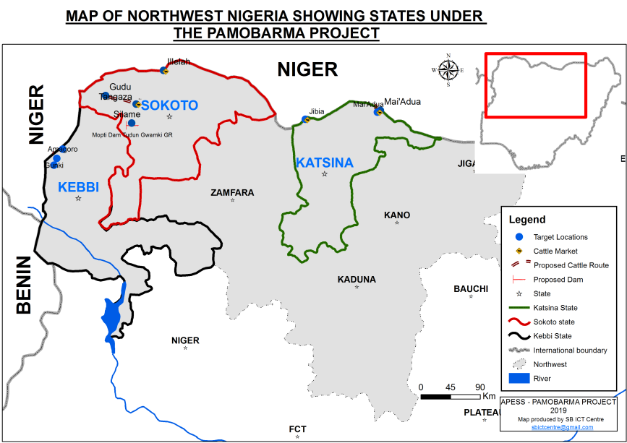

Slide 5
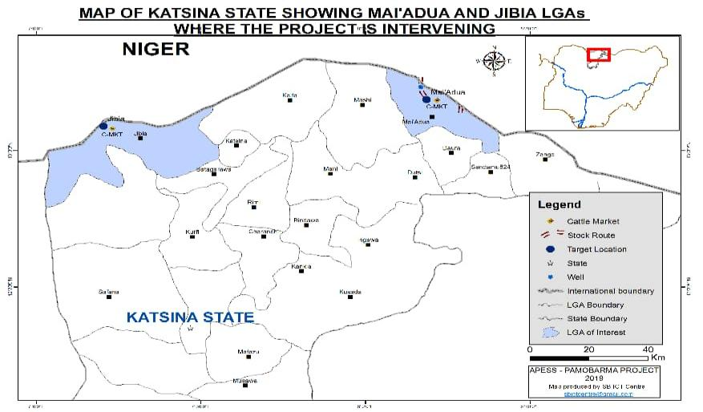

Slide 6
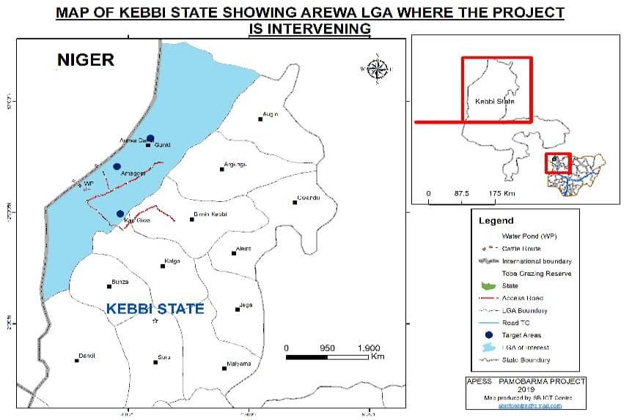

Slide 7
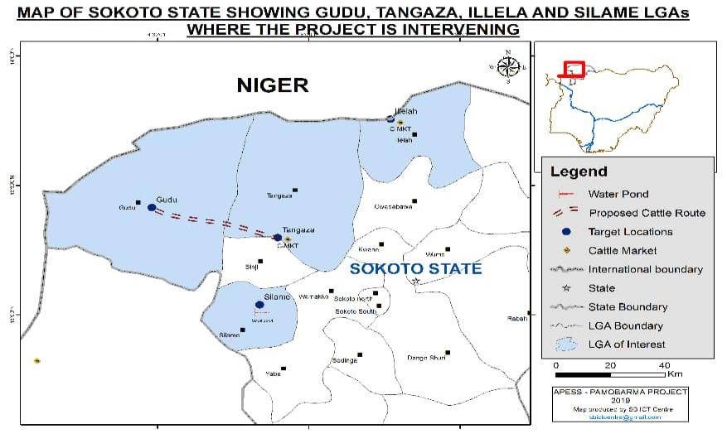

Slide 8
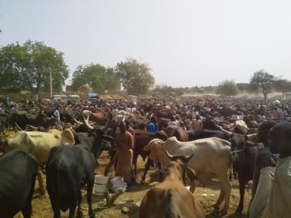
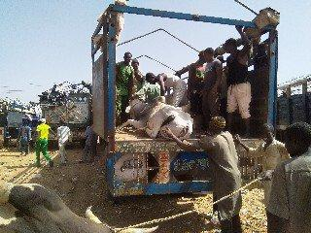
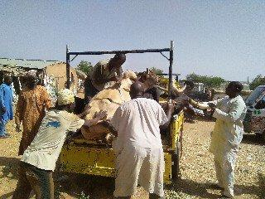
Amagoro Market in Kebbi State

Slide 9
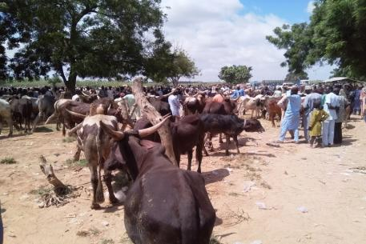
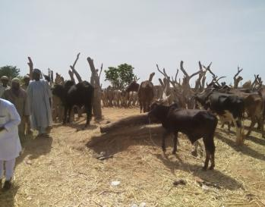
Gumki Market in Kebbi State

Slide 10
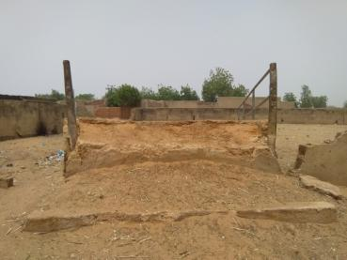
Maiadu’a Market in Katsina State

Slide 11
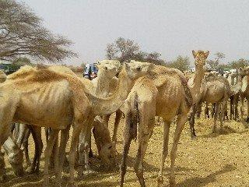
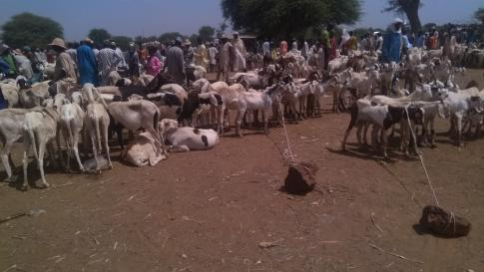
Illelah Market in Sokoto State

Slide 12
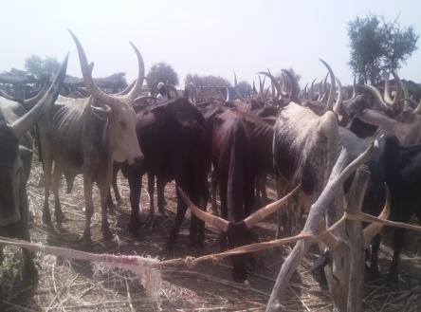
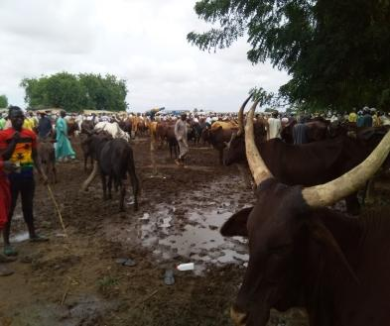
Tangaza Market in Sokoto State

Slide 13
Average Number of Livestock in Six Months from the Markets
Market | Cattle |  | Small Ruminant
 | Presented | Sold | Presented | Sold
ILELAH | 20,031 | 15,438 | 118,236 | 97899
Mai’adua | 9,753 | 6550 | 27,451 | 24,345
Jibia | 2500 | 1935 | 7,610 | 6,822
Tanagaza | 3,986 | 2,668 | 40,043 | 20,193
Gumki | 12,510 | 11,932 | 9,110 | 7,230
Amagoro | 13,350 | 12,562 | 11,063 | 10,525

Slide 14
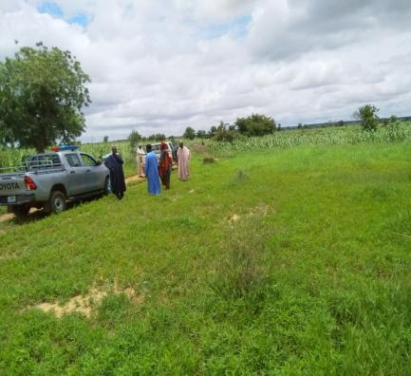
Tracing of Corridors
Tangaza- Akuya Corridor in Tangaza in Sokoto

Slide 15
Tracing of Corridors Cont.
Corridor from Sokwara Niger boarder to Amagoro cattle market in Kebbi State

Slide 16
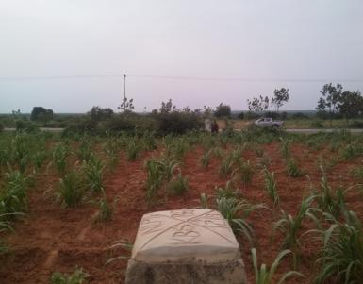
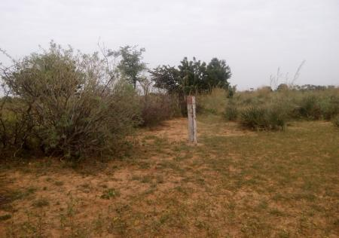
Terracing of Corridors Cont.
Encroachment along Kaoje-Bagudo- Zagga-Dakin Gari upto Toba Grazing in Kebbi State originating from Benin Republic
Nigerien Monument on the Corridor from the boarder to Mai’ adua cattle market in Katsina State

Slide 17
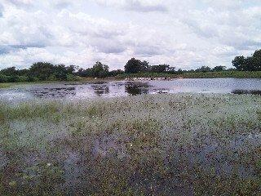
Water Ponds and Well for Rehabilitation
Mopti Pond in Silame LGA Sokoto state
Toba Pond in Arewa LGA Kebbi State

Slide 18
Water Ponds and Well for Rehabilitation Cont.
A Well targeted for rehabilitation on the corridor from Niger to Mai’ adua cattle market in Katsina State

Slide 19
Achievements in 2018-2019
High level advocacy and sensitization
Diagnosis of markets, corridors and water points
Identification of sites where the project will intervene
Conduct of Project Inception Workshop with 60 participants from across all Governments, Security Agencies, NGOs and Communities.

Slide 20
Achievements in 2018-2019 Cont.
Organized 6 Social Engineering Meetings with Stakeholders within the markets identified for intervention.
Met with Security Agencies (Police, Nigerian Army, Nigerian Civil Defense Corps, State Security Service and the Immigration Service).
Participation in Conflict Resolution Meetings Convened States to Resolve Pastoralists and Farmers Crisis.

Slide 21
Activities Planned for 2020
Negotiate and Sign Agreements with the 3 Market Associations identified for intervention.
Conduct the 2nd Training of Facilitators on the Livestock Trading Module in West Africa
Conduct Informed Debates in the 3 project states
Procure a Consultant for Civil Works and launch Tender to Procure Contractors for Civil Works (Markets and Corridors)
Award Contracts for Civil Works (Markets and Corridors)

Slide 22
Activities Planned for 2020 Cont.
Commence Construction Work at Gumki, Ilelah and Maiadu’a Markets.
Secure and Demarcate approximately 100km of Corridors in the 3 states:
Maiadu’a to Niger Boarder (7km)
Tangaza Market to Akuya Watering Point (11km)
Niger Boarder to Toba Grazing Reserve (60km)

Slide 23
Major Events During the Year
Politicization of pastoralism as a mode of production, grazing reserves and ranches.
Enactment of Anti-Open Grazing Laws Benue, Taraba and Oyo states
Development and Launching of National Livestock Transformation Plan (NLTP) by the Federal Government.
NLTP Pilots to commence in Adamawa, Benue, Plateau, Nassarawa, Niger, and Taraba states.
Katsina state established an Agency specifically for Livestock Development

Slide 24
Major Events During the Year Cont.
Field Missions by APESS BURKINA FASO 3 TIMES, AFL 2 TIMES, and CILSS
Courtesy visits on Hon. Minister of Agric. by APESS, AFL and CILSS
Reconciliation between pastoralists and farmers in project focused States
Rapid response on Security by the Government (Deployment of Security Forces and Dethronement of Traditional Rulers collaborating with Armed Groups
Negotiation and Amnesty for Armed Groups
Closure of Nigerian Boarders due to Insecurity and Economic sabotage

Slide 25
Challenges
The Nigeria’s 2019 pre and post election activities delayed the commencement of project activities as perceived in the work plan
The unique Nigerian context (Land Tenure system, Encroachment Issues, Debates on Pastoralists’ Mode of Production)
Domestication of Work Plan
Perception of partners on the funding pattern of the project
Security Challenges

